Slide 1
Programming Study Pointer
Sungwoo Nam
2019.3.11

Slide 2
Pointer Usage
int a = 1234;
int *pa = &a; // pa is pointer of a
*pa = 1111; // assignment on *pa will change a also
int &ra = a; // ra is reference of a
ra = 4321; // assignment on ra will change a also

Slide 3
Function Return using reference and pointer
int AddAndMultiply(int a, int b, int& mult)
{
mult = a * b;
return a + b;
}
int AddAndMultiplyV3(int a, int b, int* mult)
{
*mult = a * b;
return a + b;
}
int mult = 0;
int sum = AddAndMultiply(1, 2, mult);
sum = AddAndMultiplyV3(1, 2, &mult);

Slide 4
Function Return using struct
struct AddMult
{
int Add;
int Mult;
};
AddMult AddAndMultiplyV3(int a, int b)
{
AddMult r;
r.Add = a + b;
r.Mult = a * b;
return r;
}
AddMult r = AddAndMultiplyV3(1, 2);
sum = r.Add;
mult = r.Mult;

Slide 5
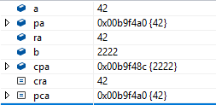
Const Usage
const int* cpa = &a;
*cpa = 42; // compile error : cpa is const pointer
cpa = &b; // but you can make it point others
const int& cra = a;
cra = 42; // compile error : cra is const reference
int* const pca = &a;
*pca = 42; // no problem
*pca = &b; // compile error : pointer itself is const

Slide 6
Const on class method
struct AddData
{
int A;
int B;
mutable int C = 0; // ok to be changed on const method
int AddAll() const // This doesn’t change member variable
{
if (C == 0) { C = A + B; }
return C;
}
};

Slide 7
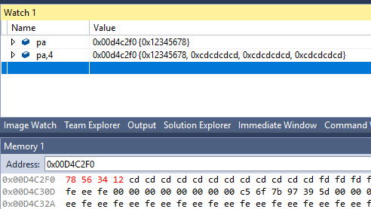
Endianess
uint32_t *pa = new uint32_t[4];
pa[0] = 0x12345678; // note the little-endian
pa[1] = 0x87654321;
pa[2] = 0x10101010;
pa[3] = 0xCAFEBEEF;
*pa = 0xFFFFFFFF;
*(pa + 1) = 0xEEEEEEEE;
delete[] pa;

Slide 8
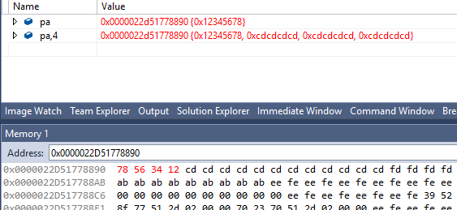
x64 application
uint32_t *pa = new uint32_t[4]; // note pa is 64 bit length
pa[0] = 0x12345678;
pa[1] = 0x87654321;
pa[2] = 0x10101010;
pa[3] = 0xCAFEBEEF;
*pa = 0xFFFFFFFF;
*(pa + 1) = 0xEEEEEEEE;
delete[] pa;

Slide 9
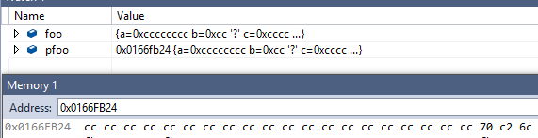
Struct pack
struct Foo
{
uint32_t a; // 4 Bytes
char b; // 2 Bytes
uint16_t c; // 2 Bytes
bool d; // 4 Bytes
const char * e; // 4 Bytes
};
Foo foo;
Foo* pfoo = &foo;
foo = { 0x12345678, 'a', 0xCAFE, true, nullptr };

Slide 10
Function Pointer
int TestBar(char a) { return a + 42; }
int TestToo(char a) { return a + 22; }
typedef int(*FooFn)(char);
FooFn f = TestBar;
int ret = f('a');
f = TestToo;
ret = f('b');

Slide 11
Function Pointer using STL
int TestBar(char a) { return a + 42; }
int TestToo(char a) { return a + 22; }
using FooFn = std::function<int(char)>;
FooFn fn = TestBar;
int ret = fn('a');
fn = TestToo;
ret = fn('b');

